Slide 1
CSTS Data Entry
The Cardiovascular Surgery Translation Study (CSTS)
JHU Armstrong Institute for Patient Safety & Quality

Slide 2
Objectives
To understand the importance of accurate data collection and entry.
To understand the data collection and entry requirements for the CSTS.
To outline next steps towards implementing data collection activities as part of CSTS.
Notes:
We will discuss the following:

Slide 3
Importance of “Good” Data
We must ensure that the data we collect are accurate, complete and in the required format.
The data we collect and enter are the ultimate proof of our success & de-identified, aggregated data will be shared broadly (i.e., they will influence care and policy).

Slide 4
Roles of Data
Baseline – Tells us where we are at the start.
On-going – Tells us whether and how we are changing our outcomes and performance.
Overall – Tells us what impact we (i.e., the project and its initiatives) have on the goal of reducing/eliminating Healthcare Associated Infections (CLABSI, SSI, VAP).

Slide 5
Data Flow
Collect Data
Enter data into web-based tool
Complete quality checks
Store data in database
Data analysis and Reporting
Notes:
5

Slide 6
Collect Data

Slide 7
CSTS Timeline
Planned Roll-out
  CLABSI Prevention interventions and monthly data collection: June 2011
  SSI Prevention interventions and monthly data collection: approximately September 2011
  VAP Prevention interventions and monthly data collection: after December 2011

Slide 8
CLABSI Data
Data for this project are collected according to National Healthcare Safety Net (NHSN) definitions for catheter-line associated blood stream infections (CLABSI).
http://www.cdc.gov/nhsn/

Slide 9
CLABSI Data
Baseline: entered once at start of project. Usually for the year preceding the start of the immersion calls. For this project, baseline is entered for the entire year (instead of monthly).
Monthly: entered by the 15th of the month.
  For example, June’s data is entered by July 5th.
Total number of CLABSIs in the unit for the period of interest (baseline or month). Numerator
Total number of central line days in the unit for the period of interest(baseline or month). Denominator

Slide 10
Enter data into
web-based tool

Slide 11
Data Entry
Web-based data entry tool. Tool provides for data entry and reporting
Baseline data entered prior to work with CSTS checklist and methods. Monthly data entered by the 15th of each month.
Users can edit monthly data. Rolling 6-month lock on the data.
Data quality checks built into the system.
Web-based system will send reminders of data due & overdue

Slide 12
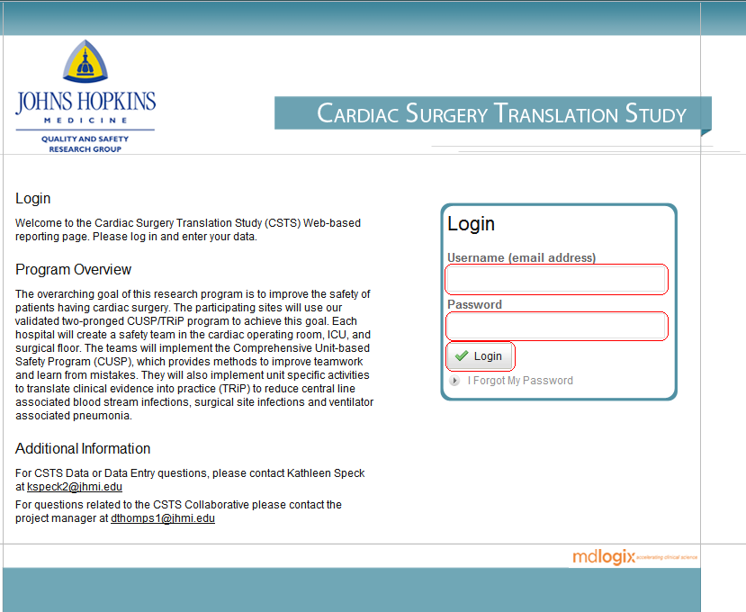
CSTS Data Entry System

Slide 13
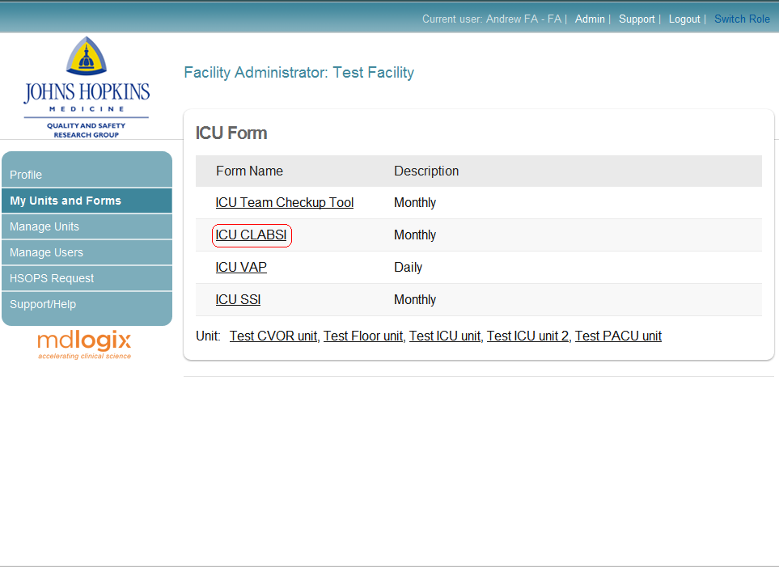
Data Entry CLABSI
Select the form for which you want to enter data.

Slide 14
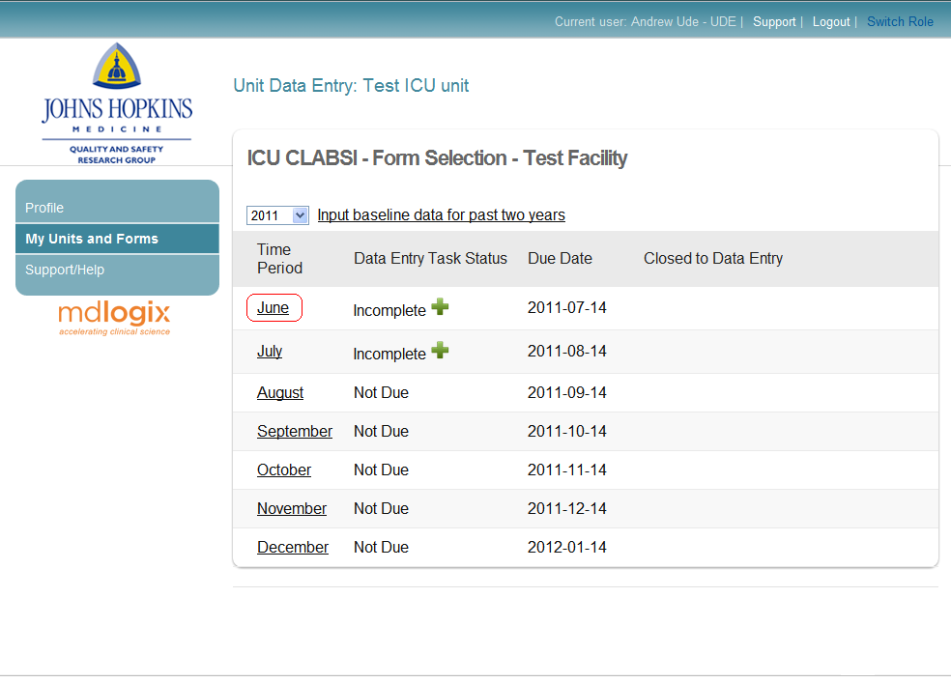
Data Entry CLABSI
Select the month for which you want to enter data.

Slide 15
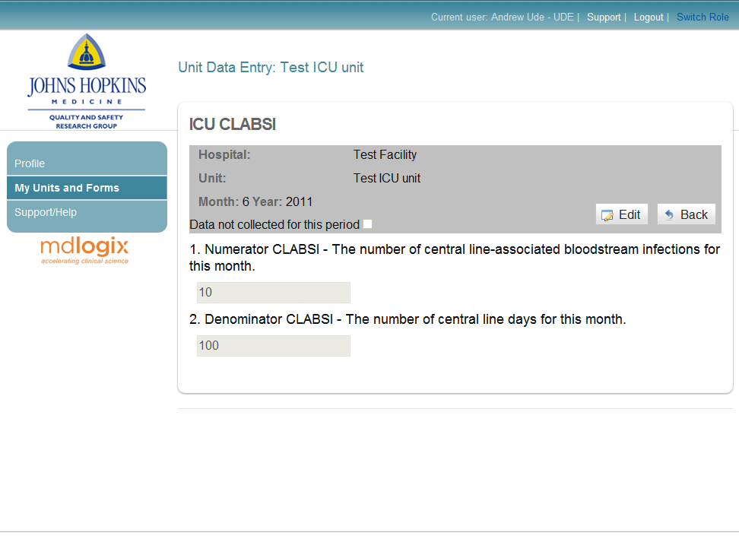
Data Entry CLABSI
Either enter numerator & denominator OR check “data not collected for this period.”
Notes:
Fill out the information and click Save.

Slide 16
Complete quality checks
Data must be entered sequentially. Cannot enter data for July until June’s data entry is complete.

Slide 17
Complete quality checks
No fields may be left blank. Data will not be saved if a field is left blank.

Slide 18
Complete quality checks
Cannot have the same denominator (total number of central line days) in two consecutive reporting periods

Slide 19
Complete quality checks
Cannot have > 2 SD difference in numerator (number of catheter line associated blood stream infections).

Slide 20
Complete quality checks
The numerator cannot be greater than the denominator (can’t have more infections than line days).

Slide 21
Resolving Data Problems
If the data entry system alerts you to a problem with the data. Please check to make sure that the data you’ve entered are correct.
  > 2 SD difference in numerator
  Same denominator in 2 sequential reporting periods
  Numerator greater than denominator
You can still enter the data but need to check with your infection preventionist/hospital epidemiology to ensure the data are correct.
If you need to make a correction you can edit the data.

Slide 22
Store data in database

Slide 23
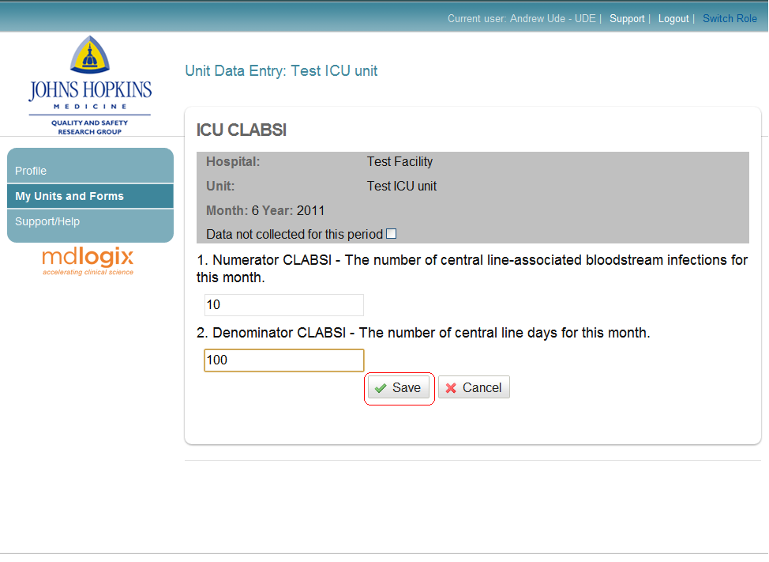
Data Entry CLABSI
Remember to click on Save to write & save data to the database.

Slide 24
Summary
Teams will collect & enter data monthly.
CLABSI data will be collected first with SSI & VAP rolled out in the future.
All teams complete a Monthly Team Checkup Tool.
Ensuring data quality is of utmost importance.
Complete training on the web-based data base.
Watch for information & training on HSOPS, SSI, VAP

Slide 25
Action Items
Identify HOW and from WHOM monthly CLABSI data (numerator & denominator) will be obtained.
Determine the process for completing the Team Checkup Tool monthly for your clinical area.
Identify WHO will be responsible for data entry in your clinical area.
Ensure that everyone involved in data entry is trained & understands what they need to do.
Develop a process for ensuring data quality control.

Slide 26

Team Checkup Tool
Mike Rosen will now talk with you about the Monthly Team Checkup Tool.
Notes:
Click ICU Team Checkup Tool.

Slide 27
Team Checkup Tool
The Cardiovascular Surgery Translation Study (CSTS)
JHU Armstrong Institute for Patient Safety & Quality

Slide 28
What is the TCT?
Measures CUSP team activities and interactions, leadership support, intervention spread on the unit
Monthly form (for first 6 months; then drops to quarterly)
Turned in by the 15th of each month for the last month (e.g., Feb TCT due Mar 15)
Used in the KICU CLABSI collaborative, the RWJF-CLABSI collaborative, National Stop BSI and the Keystone Surgery collaborative
Notes:
Note we normally see a lot of month to month change over the first 6 months or so, so it is important to measure it that frequently.
Each unit will be submitting TCT,

Slide 29
Why the TCT?
Importance of measuring process
  How will you know what is not working?
  How will we know the intervention was in fact used by teams?
The measurement of team implementation activities, functioning, and leadership support is often missing or incomplete in QI/PS initiatives and thus the full extent of the QI/PS team influence on outcomes is unknown

Slide 30

Ways you can use the TCT
Use the form as a project management tool (e.g., a checklist)
Check in with your team about what they think
Report your activity upward to management (highlight needs)
Monitor your progress in CUSP steps and CLABSI/ SSI/ VAP reduction steps
Identify barriers in teamwork and communication to guide corrective action
Identify activities of other teams; compare pace of your project

Slide 31
Other ways the TCT can help you
Faculty can use to respond to educational needs of teams
Society and science can learn from the elements of team context that influence performance

Slide 32
What we have learned from TCTs in other projects
  The Team Check-Up Tool demonstrates good measurement reliability, validity and responsiveness (RWJF-Adventist data)(Chan et al. 2010, submitted)
  Participation in CUSP (measured on the TCT) is associated with significant improvement in Safety Attitudes Questionnaire scores over 2 years –that means CUSP participation improves Safety Culture!(Michigan Keystone data) (Hsu dissertation 2011)

Slide 33
  Useful knowledge from the TCT
Five months of Keystone data (~107 ICUs), Mar-Jul 05
  More frequent senior executive meeting was associated with lower CLABSI rates (IRR=0.76, p<0.001).
  Not enough leadership support from executives was associated higher CLABSI rates (IRR=2.84, p=0.001)
  Inability to work together was associated with higher CLABSI rates (IRR=3.11, p=0.037)

Slide 34
  Useful knowledge from the TCT
Adventist data (45 ICUs), Mar 07 - Feb 08
  Educational activity “infection control visit/talk” was associated with higher CLASBI rates (IRR=2.44, p=0.012)
  Appropriate hand hygiene was associated with lower CLABSI rates (IRR=0.41, p=0.019)
Notes:
First bullet likely indicates that the IP visits the unit or gives a talk after there is an infection

Slide 35
  Useful knowledge from the TCT
Adventist data (45 ICUs), Mar 07 - Sep 08
  ICU teams reporting work distractions were less likely to perform full-barrier precautions (coef.=-0.13, p=0.034) and remove unnecessary lines (coef.=-0.14, p=0.009)

Slide 36
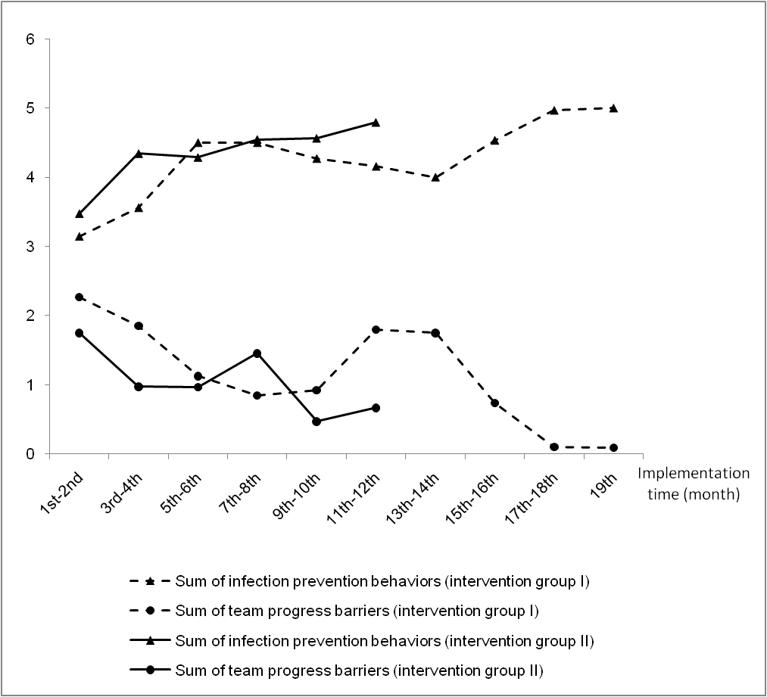
Notes:
Adventist ICUs were split into two groups and started the intervention 7 months apart. Here you can see how data from the TCT let us know what was happening across the teams. In the first year of intervention, BOTH intervention groups saw the same pattern, a divergence between the spread of infection prevention behaviors on the unit (a sum of the scores for the 5 EBPs) and the number of progress barriers they were reporting. The group that intervened longer, saw a plateau at a year, but then even greater progress. This also shows that there is variability over time that we may miss when we measure less frequently, but we are cognizant of your response burden.

Slide 37
Conclusion
Measuring process is critical to your progress
High quality data and regular submission of data is essential to the project’s success and
Project success will establish the public legacy of your efforts

